Slide 1
What is UVM?
UVM = Universal Verification Methodology
A standardized verification methodology for hardware design verification
Built on top of SystemVerilog
Used to create structured, reusable, and scalable testbenches based on object-oriented programming concepts
It also includes a set of guidelines and best practices for developing testbenches, as well as a methodology for running simulations and analyzing results.
Widely adopted by semiconductor industry

Slide 2
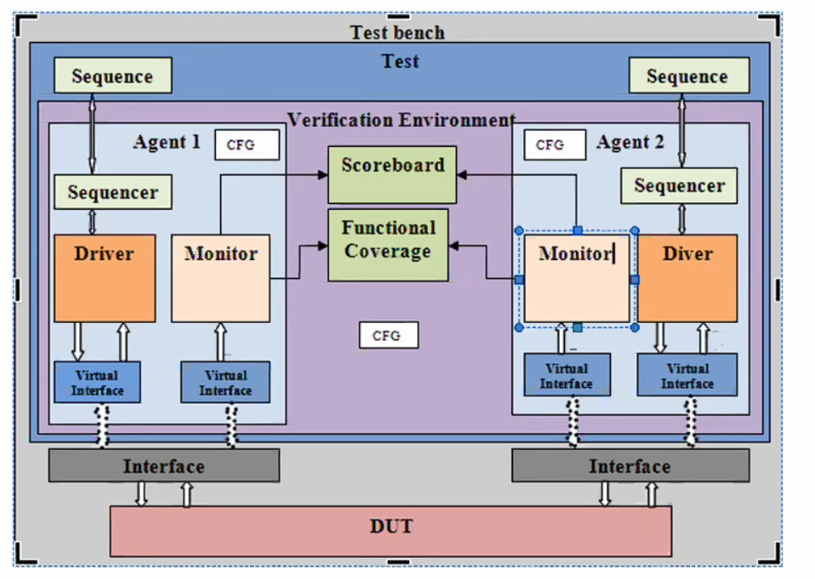
Outline
01
UVM Fundamentals
04
Architecture & Components
02
Advantages & Challenges
05
Phases, TLM & Configuration
03
Introducing PyUVM
06
Cocotb

Slide 3
UVM Hierarchy
Class | Purpose
Sequence item | is a transaction that is communicated between the class environment and the DUT
Sequencer | Generate data structure and send it to the driver
Driver | Receiving transaction from the sequencer and Drive this data to the virtual interface instance connected to the DUT
Monitor | Capture the data signals from the virtual interface instance connected to the DUT
Agent | Contains the Sequencer, Driver and Monitor, There can be more than one agent in a single environment ,each agent should connect to a separate interface Agent can be: Active agents: Responsible for driving sequences to DUT and monitoring them Passive agents:Responsible for monitoring output from the DUT
Enviroment | Gather all agents in single component,It may also contain other smaller environments that has been verified at block level and now integrated into a subsystem.
Scoreboard | Checker that determines if test Passed/Failed
Subscriber

Slide 4
Advantages of UVM in Verification
Reusability: same agent can be reused across multiple projects
Scalability: works for small blocks up to large SoCs
Standard structure:Engineers can understand each other’s testbenches faster
Constrained-random testing: generates many legal stimulus scenarios automatically
Functional coverage: what scenarios were actually tested
TLM communication:components exchange transactions cleanly
Factory mechanism:allows easy component replacement without changing base code
Better maintainability:easier to extend than ad hoc testbenches

Slide 5
The Problem with Traditional UVM
Expensive commercial tools required — Synopsys VCS, Cadence Xcelium, Siemens Questa all need costly licenses
Requires strong knowledge of SystemVerilog OOP
Learning curve is high for students and new verification engineers
Debugging can be difficult
Less friendly for software-oriented engineers
Integrating Python models, data processing, or ML logic is less natural
Running pure open-source flows is harder than with Python-based verification

Slide 6
What is PyUVM?
Python implementation of the UVM 1800.2 standard
Fully open-source under the Apache 2.0 license
Leverages Python's object-oriented features to implement UVM class hierarchy
Works on top of cocotb for RTL signal interaction
Removes much of the SystemVerilog complexity
Especially useful for:
education
research
Prototyping
open-source verification flows

Slide 7
Advantages of PyUVM over Traditional UVM
Open Source No expensive licenses. Free for everyone — academia, startups, hobbyists.
Python-Based Cleaner syntax, faster development cycles.
Rich Ecosystem Access NumPy, SciPy, ML libraries, and thousands of Python packages.
Faster Iteration No compilation step for testbench code. Edit and re-run instantly.
Better Debugging Python debuggers (pdb, IDE debuggers), rich logging, REPL exploration.
Lower Learning Curve Python is more accessible. New engineers become productive faster.
Large Community Python's massive developer community means abundant resources and support.

Slide 8
PyUVM Testbench Architecture

Slide 9
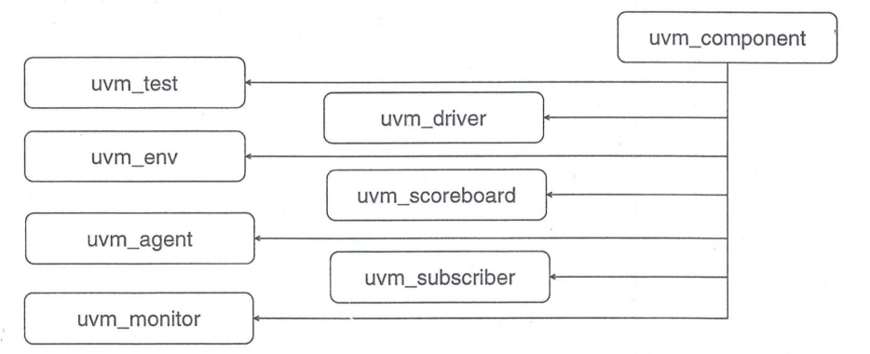
UVM Component Classes

Slide 10
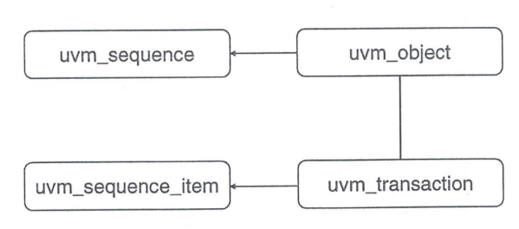
UVM Object Classes

Slide 11
Components VS Objects :
Components :
Used to build the test bench structure
Model TB hierarchy
Static-like(Quasi-Static) structures that are created during run time and they are persistent throughout the simulation
Objects
Used for stimulus modeling (transactions)
No hierarchy
During the simulation, many objects will be created when required, and once used they will be disappeared

Slide 12
Code Example
from pyuvm import uvm_agent, uvm_driver, uvm_env, uvm_monitor, uvm_scoreboard,uvm_sequencer, uvm_test, test
class ALUSequencer(uvm_sequencer):
...
class ALUDriver(uvm_driver):
...
class ALUMonitor(uvm_monitor):
...
class ALUScoreboard(uvm_scoreboard):
...
class ALUAgent(uvm_agent):
...
class ALUEnv(uvm_env):
...
@test()
class AddTest(uvm_test):
...
@test()
class SubTest(uvm_test):
...
@test()
class AndTest(uvm_test):
...

Slide 13
Phases
Synchronization between testbench components
Methods that do not consume simulation time are functions and methods that consume simulation time are tasks.
User has the ability to add a user defined phase.
phases is defined inside the component classes only.
Phases can be grouped into three categories:
Build time phases
Run time phases
Clean-Up phases

Slide 14
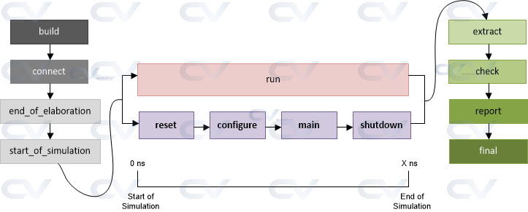
Phases
Functions Task Functions

Slide 15
Phases
Phase Category | UVM Phase Name | Method Type | Description
Build | build_phase | function | Used to build testbench components and create their instances
 | connect_phase | function | Used to connect between different testbench components via TLM ports
 | end_of_elaboration_phase | function | Used to display UVM topology and other functions required to be done after connection
 | start_of_simulation_phase | function | Used to set initial run-time configuration or display topology
Run | run_phase | task | Actual simulation that consumes time happens in this UVM phase and runs parallel to other UVM run-time phases.
Clean | extract_phase | function | Used to extract and compute expected data from scoreboard
 | check_phase | function | Used to perform scoreboard tasks that check for errors between expected and actual values from design
 | report_phase | function | Used to display result from checkers, or summary of other test objectives
 | final_phase | function | Typically used to do last minute operations before exiting the simulation

Slide 16
Phase
Build Phase
The build phases are executed at the start of the UVM test bench simulation and their overall purpose is to construct, configure and connect the test bench component hierarchy
All the build phase methods are functions and therefore execute in zero simulation time

Slide 17
Phases
Build Phase (sub-phases)
Build :
Executes top down
Connect :
Executes bottom up
End of elaboration :
Executes bottom up
Start of simulation :
Executes bottom up

Slide 18
Phases:
2) Run Time phase:
The UVM executes the run phase and the phases pre_reset through to post_shutdown in parallel

Slide 19
Phases
3) Clean-up phases
The clean up phases are used to extract information from scoreboards and functional coverage monitors to determine whether the test case has passed and/or reached its coverage goals .
Take zero time to execute
Used by analysis components
Work bottom up

Slide 20
Objections Management
UVM objections are used to synchronize between the UVM phases
Run Phase runs in parallel in all component and consumes time in each one, so objection synchronize this process
As long as the objection is raised on certain phase for example the run phase , other phases after run phase are blocked.
Once the objection is dropped, other phases can start
it is used in test class only
async def run_phase(self):
self.raise_objection()
await sequence.start(self.env.agent.seqr)
self.drop_objection()

Slide 21
TLM
TLM means Transaction-Level Modeling.
Instead of passing raw signals, components communicate using transactions.
That makes verification code more reusable and easier to reason about.
Common TLM usage includes sequencer to driver, monitor to scoreboard, monitor to subscriber, and FIFO-style channels.
In PyUVM, TLM ports and exports are used to connect producers and consumers of transactions.

Slide 22
Types of TLM with Figure and Code

Slide 23
Configuration

Slide 24
What is cocotb?
cocotb is a coroutine-based cosimulation framework for verifying HDL designs in Python.
It gives Python code access to simulator objects and DUT signals.
Uses coroutines (async / await) for timing control

Slide 25
How PyUVM Uses cocotb?

Slide 26
Open-Source Simulation Tools
Common open-source simulators used with cocotb/PyUVM
Icarus Verilog
simple and easy to start with
mainly for Verilog
good for learning and small projects
Verilator
very fast
converts Verilog/SystemVerilog subset into C++
widely used in open-source flows
strong for RTL simulation, but not full SystemVerilog/UVM support
GHDL
open-source VHDL simulator
useful for VHDL designs
GTKWave
not a simulator, but waveform viewer
used to inspect simulation signals

